Slide 1
Object-Oriented Programming (OOP)
Week – 03
Feb 03-07, 2019
Instructor: Basit Ali
Email: basit.jasani@nu.edu.pk
Object-Oriented Programming (OOP)

Slide 2
Constructor
A constructor is a member function of a class which initializes objects of a class.
In C++, Constructor is automatically called when object(instance of class) create

Slide 3
How constructors are different from a normal member function?
Constructor has same name as the class itself.
Constructors don’t have return type.
A constructor is automatically called when an object is created.
If we do not specify a constructor, C++ compiler generates a default constructor for us (expects no parameters and has an empty body).

Slide 4
Types of Constructors
Default Constructor: Default constructor is the constructor which doesn’t take any argument. It has no parameters.
Parameterized Constructors: It is possible to pass arguments to constructors. Typically, these arguments help initialize an object when it is created.
Copy Constructor: A copy constructor is a member function which initializes an object using another object of the same class.

Slide 5
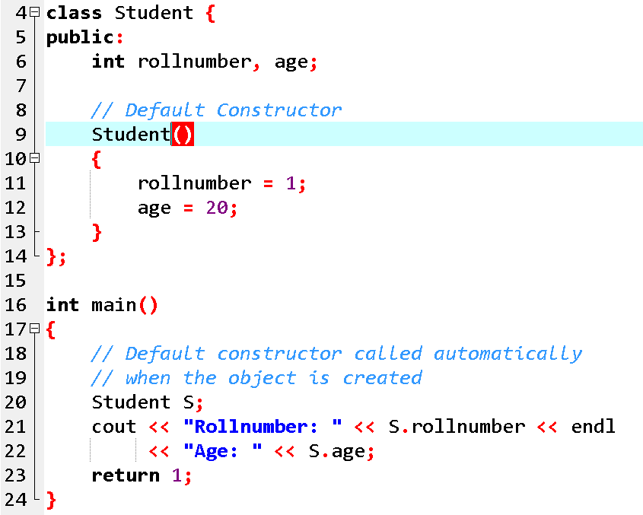
1. Default Constructor
Note: Even if we do not define any constructor explicitly, the compiler will automatically provide a default constructor implicitly.

Slide 6
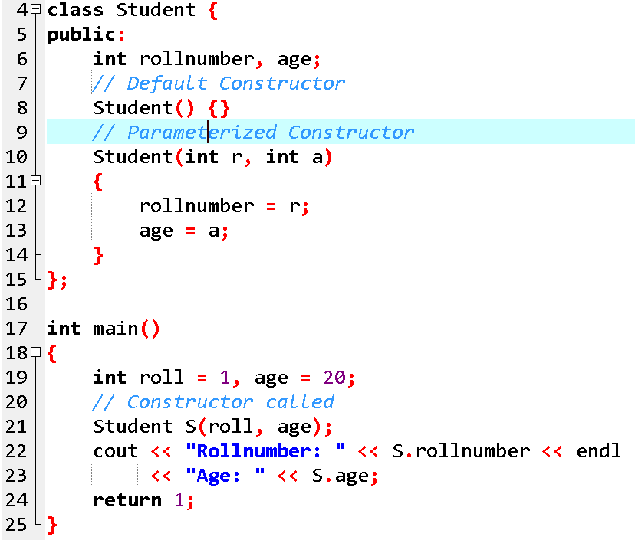
Parameterized Constructors
When an object is declared in a parameterized constructor, the initial values have to be passed as arguments to the constructor function. The normal way of object declaration may not work. The constructors can be called explicitly or implicitly.

Slide 7
2. Parameterized Constructors
Example e = Example(0, 50); // Explicit call
Example e(0, 50); // Implicit call
Uses of Parameterized constructor:
It is used to initialize the various data elements of different objects with different values when they are created.
It is used to overload constructors.
Can we have more than one constructors in a class? Yes, It is called Constructor Overloading.

Slide 8
Constructor Overloading in C++
Just like other member functions, constructors can also be overloaded. Infact when you have both default and parameterized constructors defined in your class you are having Overloaded Constructors, one with no parameter and other with parameter.
You can have any number of Constructors in a class that differ in parameter list.

Slide 9
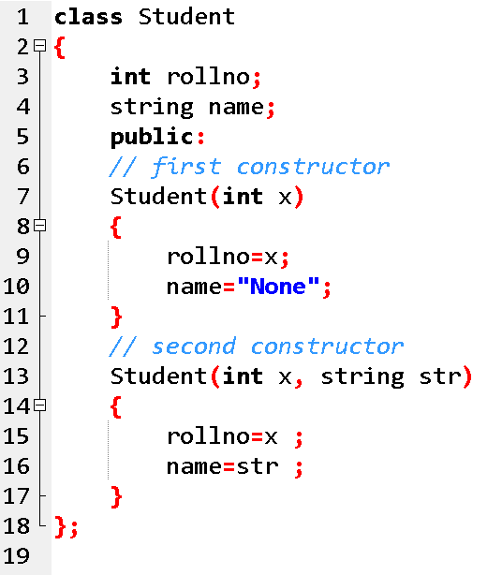
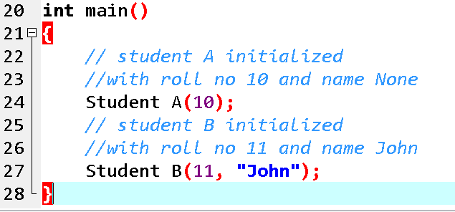

Slide 10
3. Copy Constructor
A copy constructor is a member function which initializes an object using another object of the same class.
A copy constructor has the following general function prototype:
ClassName (const ClassName &old_obj);

Slide 11
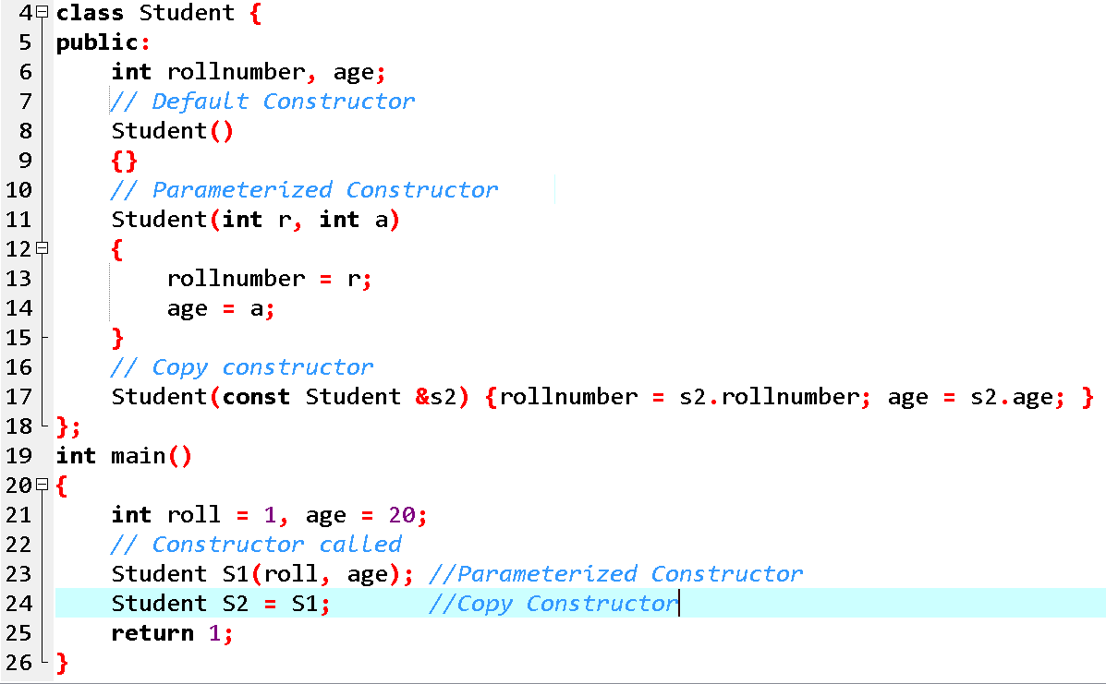
s

Slide 12
When is user-defined copy constructor needed?
If we don’t define our own copy constructor, the C++ compiler creates a default copy constructor for each class which does a member-wise copy between objects
The compiler created copy constructor works fine in general. We need to define our own copy constructor only if an object has pointers or any runtime allocation of the resource like file handle, a network connection..etc.

Slide 13
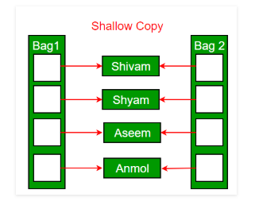
Shallow Copy Vs Deep Copy
Default constructor does only shallow copy.

Slide 14
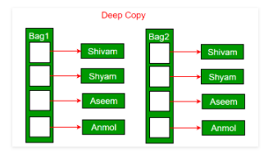
Shallow Copy Vs Deep Copy
Deep copy is possible only with user defined copy constructor. In user defined copy constructor, we make sure that pointers (or references) of copied object point to new memory locations.

Slide 15
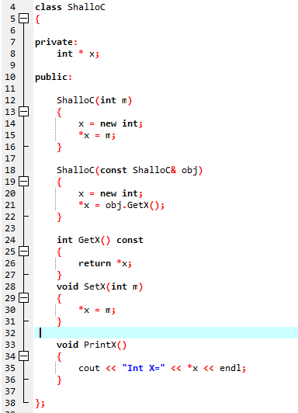
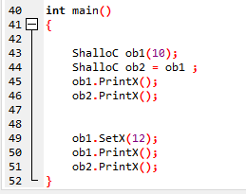
Example

Slide 16
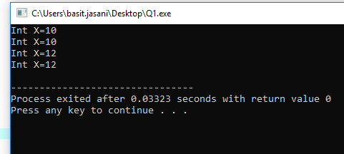
Shallow Copy (Output of Default)

Slide 17
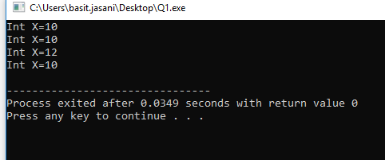
Deep Copy (Output of Defined)

Slide 18
Destructors
Destructor is a member function which destructs or deletes an object.
When is destructor called? A destructor function is called automatically when the object goes out of scope: (1) the function ends (2) the program ends (3) a block containing local variables ends (4) a delete operator is called

Slide 19
How destructors are different from a normal member function?
Destructors have same name as the class preceded by a tilde (~)
Destructors don’t take any argument and don’t return anything

Slide 20
Can there be more than one destructor in a class? No, there can only one destructor in a class with classname preceded by ~, no parameters and no return type.
When do we need to write a user-defined destructor? If we do not write our own destructor in class, compiler creates a default destructor for us. The default destructor works fine unless we have dynamically allocated memory or pointer in class.

Slide 21
